Slide 1
Modern Governments
For III Semester
B.A. History
Fr. M. Arockiasamy Xavier SJ

Slide 2
FORMS OF GOVERNMENT
Meaning of Government
The Columbia Encyclopaedia defines government as "a system of social control under which the right to make laws, and the right to enforce them, is vested in a particular group in society".
Government – power to make laws - power to rule – power to make decisions etc.,
One method of classifying governments is through which people have the authority to rule. This can either be one person (an autocracy, such as monarchy), a select group of people (an aristocracy), or the people as a whole (a democracy, such as a republic).

Slide 3
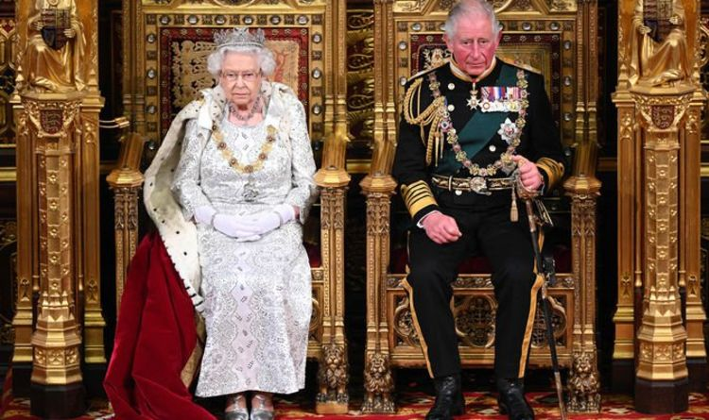
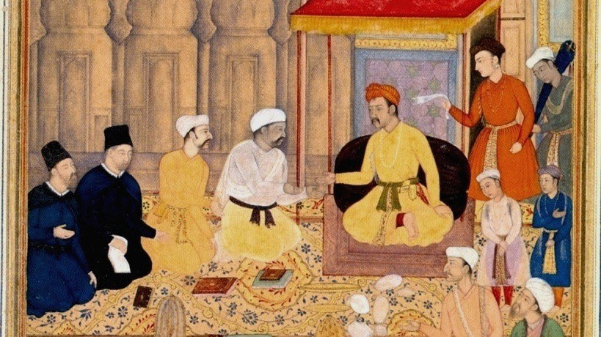
Monarchy
A monarchy has a emperor or king or queen, who sometimes has absolute power. It is the rule of the Crown. All legislature, executive, administrative and Judicial powers are in the hands of a single person ie. Monarch. Power is passed along through the family viz., hereditary.

Slide 4
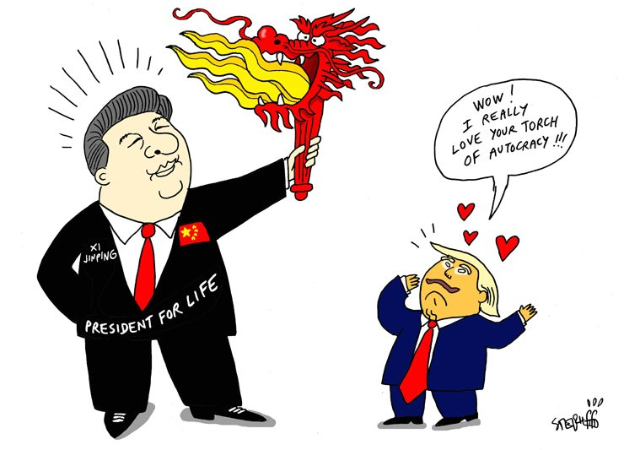
Autocracy
An autocracy is a system of government in which supreme power is concentrated in the hands of one person. His decisions are subject to neither external legal restraints nor regularized mechanisms of popular control (except perhaps for the implicit threat of a coup d ‘etat or mass insurrection).

Slide 5
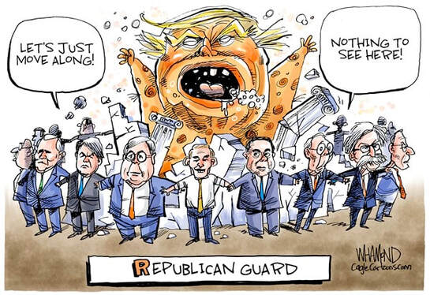
Aristocracy
Aristocracy is a form of government that places power in the hands of a small, privileged ruling class. Many monarchies were aristocracies, although in modern constitutional monarchies the monarch himself or herself has little real power. The term aristocracy could also refer to the non-peasant, non-servant, and non-city classes in the feudal system.

Slide 6
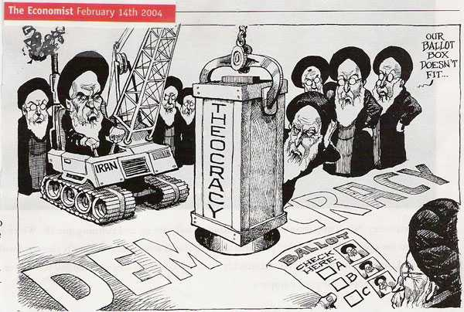
Theocracy
A form of govt. where the rulers claim to be ruling on behalf of a set of religious ideas, or as direct agents of a deity.

Slide 7
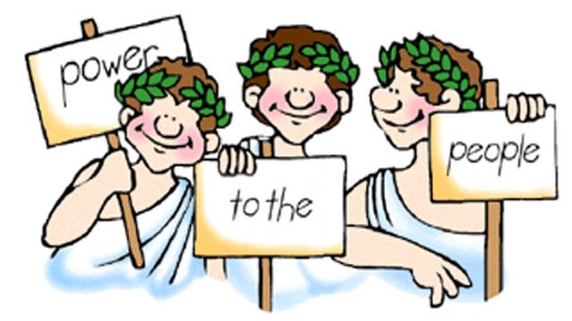
Democracy
Democracy is a system of government where the citizens exercise power by election.
In a direct democracy, the citizens as a whole form a governing body and vote directly on each issue.
In a representative democracy the citizens elect representatives from among themselves. These representatives meet to form a governing body, such as a legislature.

Slide 8
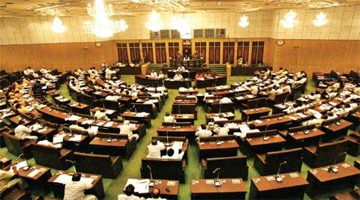
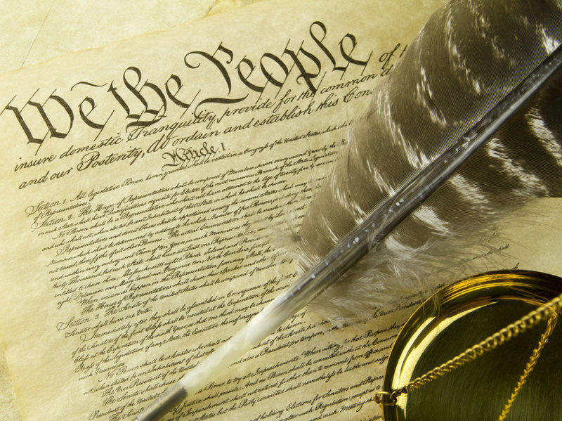
Democracy
In a constitutional democracy the powers of the majority are exercised within the framework of a representative democracy, but the constitution limits the majority and protects the minority. All citizens enjoy certain individual rights, e.g. freedom of speech, or freedom of association.

Slide 9
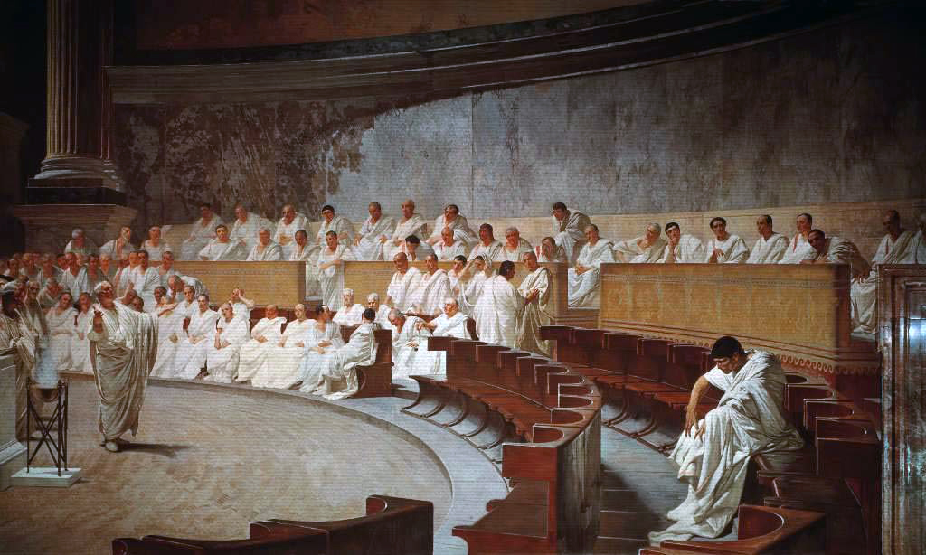
Republic
A republic is a form of government in which the country is considered a "public matter", not the private concern or property of the rulers. And where offices of states are subsequently directly or indirectly elected or appointed rather than inherited.
A common simplified definition of a republic is a government where the head of state is not a monarch. Other terms used to describe different republics include democratic republic, parliamentary republic, federal republic etc.,

Slide 10
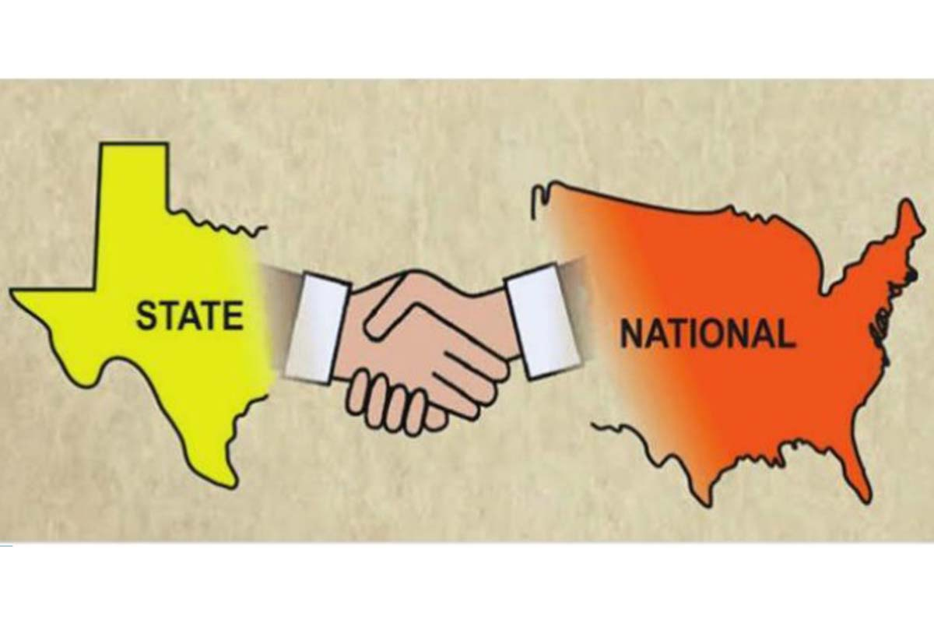
Federalism
Federalism is a political concept in which a group of members are bound together by agreement with a governing representative head . The term "federalism" is also used to describe a system of government in which sovereignty is constitutionally divided between a central governing authority and constituent political units. They are variously called states, provinces or otherwise. In Federalism the power to govern is shared between national and provincial or state governments, creating a federation . Proponents are often called federates.

Slide 11

Other governances
Another method of Descriptions of governments can be based on Economy :
what provides the goods and services that are bought, sold, and used?

Slide 12
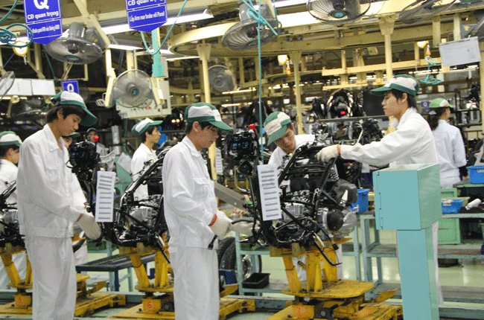
capitalism
In a capitalist or free-market economy, people own their own businesses and property and must buy services for private use, such as healthcare.

Slide 13
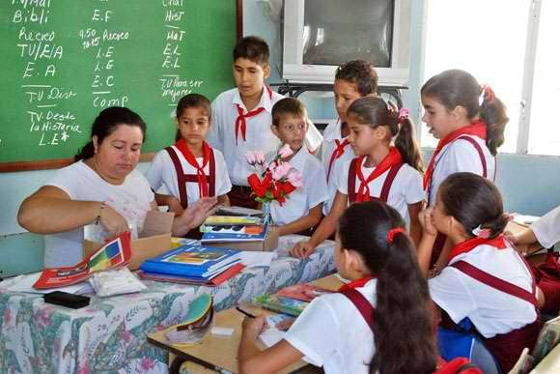
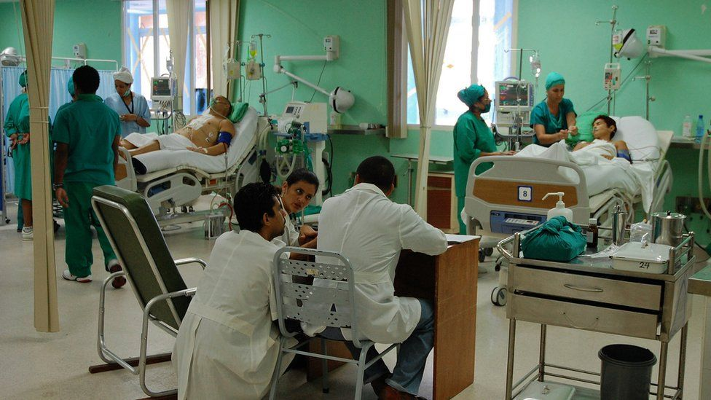
Socialism
Socialist governments own many of the larger industries and provide education, health and welfare services while allowing citizens some economic choices.

Slide 14
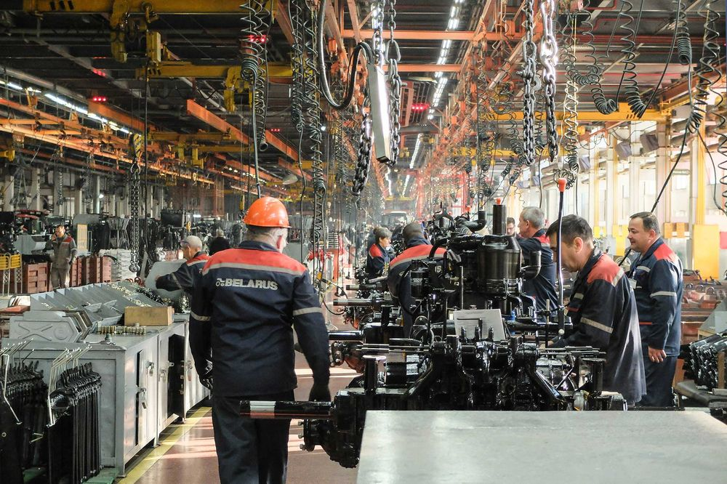
communist country
In a communist country, the government owns all businesses and farms and provides its people's healthcare, education and welfare.

